Slide 1
Learning From Examples

Slide 2
Learning from Examples
An agent is learning if it improves its performance on future tasks after making observations about the world.
Learning - jotting down a phone number, to the profound as exhibited by albert einstein - who inferred a new theory of the universe.
On one class of learning problem - restricted - vast applicability - from a collection of input and output pairs - learn a function that predicts the output for new inputs.

Slide 3
Why we want an agent to learn?
If the design of the agent can be improved- why wouldn’t the designers just program in that ?
3 main reasons….
Cannot anticipate all possible situations that the agent might find itself in…
Cannot anticipate all changes over time - A program designed to predict tomorrow’s stock market prices - learn to adapt when conditions change from boom to bust?
Sometimes human programmers have no idea how to program a solution themselves…
Ex: most people are good at recognizing the faces of family members – but programming it?

Slide 4
Forms of Learning
Any component of an agent can be improved by learning from data.
The improvements and the techniques used to make them depend on four major factors.
Which component is to be improved?
What prior knowledge the agent already has?
What representation is used for the data and the component?
What feedback is available to learn from?

Slide 5
Feedbacks to learn from
Unsupervised learning – no explicit feedback is supplied – clustering.
Supervised learning - observes input and output pairs - learns a function that maps from input to output.
Semi-supervised learning - a few labeled examples - must make what we can of a large collection of un labeled examples.
Reinforcement learning - the agent learns from a series of reinforcements - rewards or punishments.
Ex: the lack of a tip at the end of the journey gives the taxi agent an indication that it did something wrong.

Slide 6
Supervised Learning
The task of supervised learning is this:
Given a training set of N example input and output pairs,
(X1, y1), (x2, y2), (x3, y3)……..(Xn, yn)
Yj was generated by an unknown function y = f(x)
Discover a function h, that approximates the true function f.
The function h is the hypothesis.
Train set vs test set – accuracy
Classification vs regression.
When the output y – finite values – sunny, cloudy or rainy – classification.
When y is a number, the learning problem is regression.

Slide 7
Learning Decision Trees
Decision tree represents a function that takes as input a vector of attribute values and returns a decision - a single output value.
The input and output values can be discrete or continuous.
We will concentrate on problems where the inputs have discrete values and the output has exactly two possible values.
This is “boolean classification, where each positive example input will be classified as true or false.

Slide 8
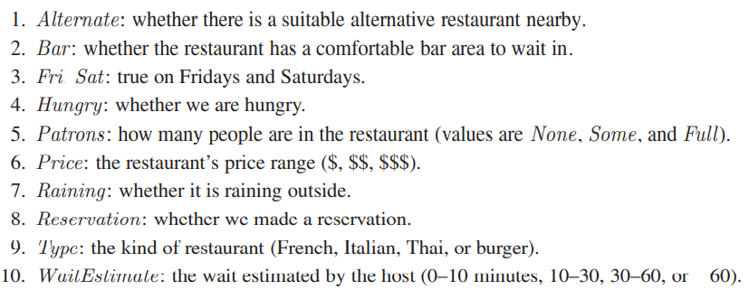
Learning Decision Trees
We will build A decision tree to decide whether to wait for A table at A restaurant. Aim - to learn a goal predicate willwait?

Slide 9
Expressiveness of Decision Tree
a Boolean decision tree is logically equivalent to the assertion that the goal attribute is true if and only if the input attributes satisfy one of the paths leading to a leaf with value true?
Writing this out in propositional logic we have
Goal ⇔ (Path1 ∨ Path2 ∨···) ,
where each path is a conjunction of attribute value tests required to follow that path.

Slide 10
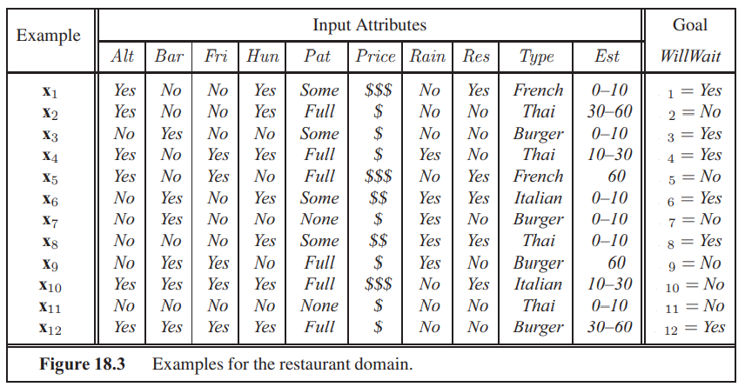
Expressiveness of Decision Tree

Slide 11
A truth table over ‘n’ attributes will have 2^n rows.
Which means it will have more than 2^(2^n) trees.
If there are 10 parameters there will be 2^1024 trees and if there are 20 parameters there will be 10^300,000 trees.

Slide 12
The decision tree algorithm adopts a greedy divide-and-conquer strategy.
Always test the most important attribute first, this test divides the problem up into smaller sub-problems that can then be solved recursively.
By the most important attribute, we mean the one that makes the most difference to the classification of an example.
That way we hope to get to the correct classification with a small number of tests meaning that all paths in the tree will be short and the tree as a whole will be shallow.

Slide 13
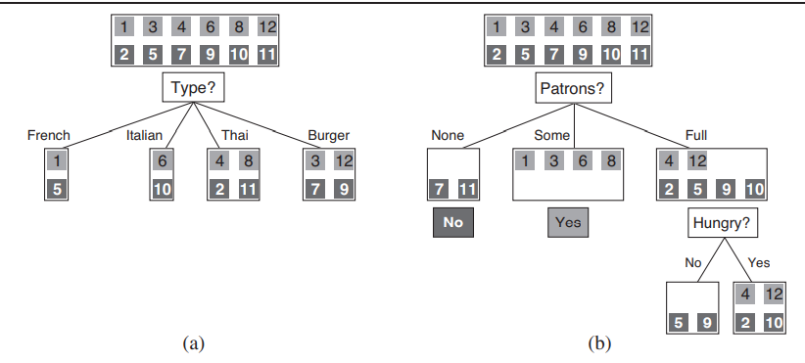
Expressiveness of Decision Tree

Slide 14
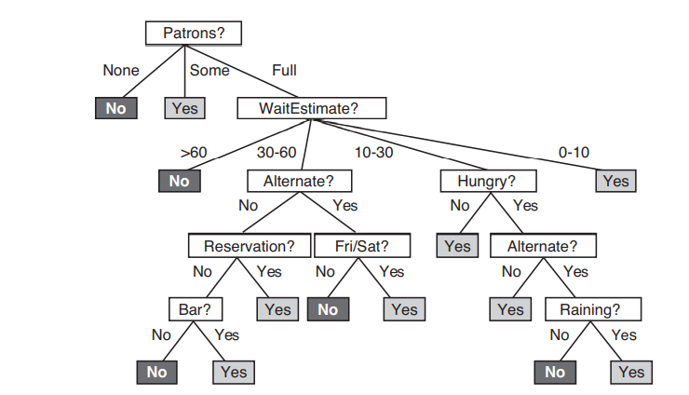
Expressiveness of Decision Tree

Slide 15
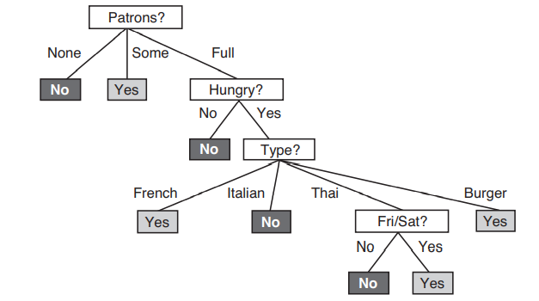
Expressiveness of Decision Tree

Slide 16
Expressiveness of Decision Tree
Eg: THE RIGHTMOST PATH
Path = (Patrons = Full ∧ Wait Estimate = 0 - 10)

Slide 17
